Slide 1

DOC311 Academic Skills for Higher Education
Presentation Skills

Slide 2
Presentations – the Good and the Bad!
  Watch this video (but don’t say guys to the audience)
    https://www.youtube.com/watch?v=5p0rTNVNWN8

Slide 3

Learning Outcomes
To learn and apply the key aspects involved with producing an effective and successful presentation by
  Preparing and delivering a presentation on a given topic (group activity – assessed).

Slide 4


Presentations – Goals
Why are you presenting?
  To communicate some idea, concept, or method to an audience.
Communication is a two-way process.
  Speaker (giver)
  Audience (receiver)
You will be judged by your ability to communicate.
  If they don’t get the message – it is not their fault!
Ultimate Goal: To communicate a message.

Slide 5
Making Presentations – Overcoming Fear
The more inexperienced you are in this area, the more nervous you will feel.
There are two ways of attempting to control your nerves:
  Never do it
  Take a risk and have a go!

Slide 6

Making Presentations – Overcoming Fear
If you never do it:
  You will never conquer your fear.
  You may impede your career as more and more managers and professionals are expected to be able to make effective presentations.
  If you take a risk and have a go:
  Your nervousness will create adrenaline that will help you to perform.
  With good preparation, the use of relaxation techniques, and more experience, the fear will lessen.

Slide 7
Building Confidence
A lack of confidence is the biggest single obstacle to delivering an effective presentation.
Lack of confidence is caused by
  Fear of looking foolish.
  Fear of the audience's reaction.
  Fear of drying up.
Lack of confidence
No improvement Avoidance
No practice

Slide 8


Building Confidence
  Overcoming the fear of drying up (forgetting or running out of things to say.
  Thorough preparation is the key.
  Prepare your own notes / cue cards.
  Timing – plan to have extra material that can be used if you have extra time.
Practice! Practice! Practice!

Slide 9
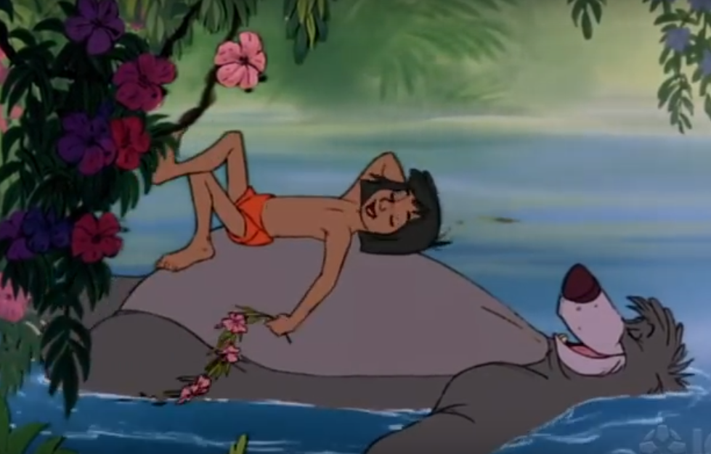
Relaxation Techniques
Practice deep breathing.
Adrenalin causes you to breath shallowly.
Breath deeply to: get more oxygen to your brain
make you calmer.
settle voice quivers
Drink water.
Adrenalin can cause a dry mouth.
Sip water occasionally
(especially when you want to emphasize a point)

Slide 10

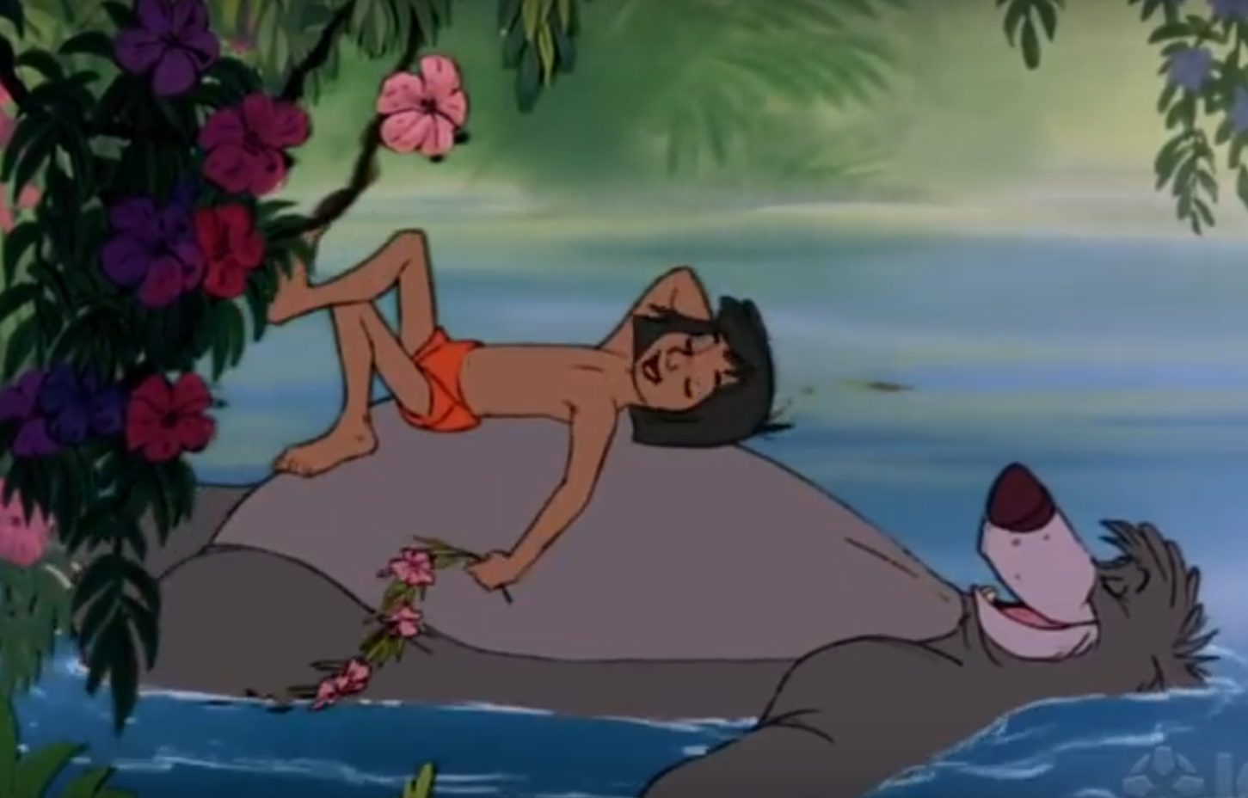
Relaxation Techniques
Smile.
A natural relaxant that sends positive chemicals through your body.
Use visualisation techniques.
Imagine an audience that is interested, enthusiastic, smiling, and reacting positively. Cement this positive image in your mind and recall it right before you are ready to go on.
Make eye contact and smile.
Just before you start talking, pause, make eye contact, and smile. This last moment of peace is very relaxing and gives you time to adjust to being the centre of attention.

Slide 11
Relaxation Techniques
Speak slowly.
Speak more slowly than you would in a conversation, and leave longer pauses between sentences.
This slower pace will calm you down, and you will be heard, especially at the back of a large room.
Move around during your presentation.
This will expend some of your nervous energy.
STOP THINKING ABOUT YOURSELF!
Remember that the audience is there to get some information and it is your job to put it across to them.
(Mindtools,n.d.).

Slide 12

Making Presentations – Stages
There are three stages involved with making presentations:
Preparation
Delivery
Planning

Slide 13
Preparation
Before you begin to prepare a presentation, you need to ask yourself
  What is the purpose of the presentation?
  Who is the audience?
  What are the circumstances?
  The purpose
  There are three categories into which the purpose of most presentations falls:
  To communication information (knowledge / teach).
  To make a proposition.
  To inspire and motivate.

Slide 14
Preparation
The audience
The members of the audience will influence the presentation in several ways.
Before beginning to prepare, consider the following questions:
  Who will be present and how many?
  How much do they know?
  What will be of interest to them?
  What attitudes, preconceptions, or expectations will they bring with them?
  Do any of them have special needs – particularly with regard to vision or hearing?
The presentation must be pitched as accurately as possible for the audience.

Slide 15
Preparation
The circumstances
  The venue
    Size of the room, the furniture, the position of equipment / slide projector, etc.
  Equipment
    The equipment / software available to you.
  The time available / allocated.
  The context
    Is the presentation at the start of the day?
    Do the audience know each other?
    Which item is your presentation in a crowded agenda?
    Are you bringing good news or bad news?

Slide 16
Planning
The objective of the presentation should be kept in mind, at all times.
A good presentation, like a good story, has a beginning, a middle, and an end.
  Introduction (Tell them what you are going to tell them)
  Body (Say it)
  Conclusion (Tell them what you told them)

Slide 17
Planning – The Introduction
  Introduction
  Prepare the introduction at the end, after you prepare the other material (as it will include the content of the rest of the presentation).
  Define the problem / objective of the presentation.
  Motivate the audience (e.g. explain what the presentation has to offer for the audience)
  Prepare an outline – Give a general outline of what will be covered in the presentation, and why.

Slide 18
Planning – The Main Section
Decide on content.
  What do you want to communicate?
Work out a logical sequence and timings.
  Decide on a sequence for the information you want to communicate.
  Repeat important points. (Emphasize the main message.)
  Do not include material / slides that you cannot explain.
Your broad outline may look like this:
Time available: 15 minutes
Introduction: 1 minute
    Main section of the presentation
    Sub heading 1 4 minutes
    Sub heading 2 4 minutes
    Sub heading 3 4 minutes
  Conclusion 2 minutes

Slide 19
Planning – The Conclusion & Recommendations
Conclusion
Refer back to the previous sections that you presented.
Summarise your points to remind the audience of what has been said.
Emphasise the important points and conclusions of your research.
Recommendations
List your recommendations (relevant to your research)
Questions?
  Make time for questions that the audience might have.

Slide 20

Before Delivering Your Presentation…
  Prepare your notes / cue cards (key words or phrases to remind you what to say).
Rehearsal and practice are important elements in the preparation of a presentation
  Confidence.
  Timings.
  Use of audio / visual material and equipment.
  Appearance / attire.

Slide 21
Delivery – Engaging the Audience
Ask real and rhetorical questions to keep people’s minds active and engaged.
  Make eye contact.
  Use appropriate facial expression. (Your face will reveal your attitudes, feelings, and emotions towards your presentation and the audience.)
  Don’t just talk to one person.
  Appropriate use of body language.
  E.g. When you are tense, you may fold your arms and look negative.
  Try to make examples interesting and compelling.
Be enthusiastic about your presentation!
Notes:
Rhetoric vs literal – questions that you don’t really expect an answer to – e.g. wouldn’t you agree that….? Sets audience thinking ; engages audience/active participation

Slide 22
Delivery – Verbal Presentation Style
Speak clearly.
Speak loudly without shouting.
  Vary the volume, speaking up to add emphasis.
  Vary your speed of delivery and pitch of your voice.
Speak to the audience, not to the screen, white board, or computer!!
Point to the screen (NOT to the computer).

Slide 23
Delivery – Using Slides Effectively
Do NOT overdo PowerPoint!
Slides should be simple, without distractions.
Slide design should be consistent (layout, structure, etc.)
Moderate use of colour.
Contrast between lettering and background.
Appropriate font size.
Each slide should
  Be concise (i.e., not verbose).
  Highlight key points.
  Have a meaningful title - not 'Introduction(5)'
  Be focused.
  Remember, be clear and accurate.
  Focus on your objective.
Notes:
Verbose – long-winded (lots of words, little substance)

Slide 24
Delivery – Using Slides Effectively
The Good
Readable, simple font.
Simple animation
Simple animation
Good colour combinations

Slide 25
Delivery – Using Slides Effectively
The Ugly
Small odd font
Odd colour combinations

Slide 26
Presenting & Public Speaking
https://www.youtube.com/watch?v=Q5WT2vweFRY&t=3shttps://www.youtube.com/watch?v=Q5WT2vweFRY&t=3s
https://www.youtube.com/watch?v=Q5WT2vweFRY&t=3s
https://www.youtube.com/watch?v=Q5WT2vweFRY&t=3s
Notes:
Group Activity – Prepare the outline for a 10-minute presentation. Task 1 – choose a topic.
Activity – Task 2 - Address and answer each of the points on slides 12 - 14
Activity – Task 3 - Decide on content for presentation.
Activity – Task 4 – Prepare the Introduction and Conclusion (how are you going to start and end the presentation?)
Activity – Task 5 – Design a slide using guidelines taught in lesson.

Slide 27
Summary
  Topics covered:
  Presentations – goals
  Overcoming fear
  Building confidence
  Relaxation techniques
  Making presentations
    a) Preparation
b) Planning
c) Delivery – Engaging the audience
Verbal presentation style
Using slides effectively
Notes:
Group Activity – Prepare the outline for a 10-minute presentation. Task 1 – choose a topic.
Activity – Task 2 - Address and answer each of the points on slides 12 - 14
Activity – Task 3 - Decide on content for presentation.
Activity – Task 4 – Prepare the Introduction and Conclusion (how are you going to start and end the presentation?)
Activity – Task 5 – Design a slide using guidelines taught in lesson.

Slide 28
References
  Mindtools, (2023). Effective Presentations Skills. [online]. Available at: https://www.mindtools.com/CommSkll/PresentationPlanningChecklist.htm [Accessed 03 March 2023].
  Mindtools, (2023). Managing Presentation Nerves. [online]. Available at: https://www.mindtools.com/pages/article/PresentationNerves.htm [Accessed 06 March 2023].
  Truelove, S., (2006). Training in Practice. London: Chartered Institute of Personnel and Development.
Notes:
Group Activity – Prepare the outline for a 10-minute presentation. Task 1 – choose a topic.
Activity – Task 2 - Address and answer each of the points on slides 12 - 14
Activity – Task 3 - Decide on content for presentation.
Activity – Task 4 – Prepare the Introduction and Conclusion (how are you going to start and end the presentation?)
Activity – Task 5 – Design a slide using guidelines taught in lesson.

